Slide 1
CGMM UNIT-1

Slide 2
What is computer Graphics?
Computer graphics is an art of drawing pictures, lines, charts, etc. using computers with the help of programming. Computer graphics image is made up of number of pixels. Pixel is the smallest addressable graphical unit represented on the computer screen.
Introduction
Computer is information processing machine. User needs to communicate with computer and the computer graphics is one of the most effective and commonly used ways of communication with the user.
It displays the information in the form of graphical objects such as pictures, charts, diagram and graphs.
Graphical objects convey more information in less time and easily understandable formats for example statically graph shown in stock exchange.
In computer graphics picture or graphics objects are presented as a collection of discrete pixels.
We can control intensity and color of pixel which decide how picture look like.
The special procedure determines which pixel will provide the best approximation to the desired picture or graphics object this process is known as Rasterization.
The process of representing continuous picture or graphics object as a collection of discrete pixels is called Scan Conversion.

Slide 3
Classification of Computer Graphics • Business graphics e.g. Bar charts, pie charts, pictograms, x-y charts etc. • Scientific graphics e.g. X-y plots, curve fitting, contour plots, flow charts. • Scaled drawings e.g. Architectural, buildings, machines, bridges etc. • Cartoons and art work. • Graphical user interface e.g. Images on screen.

Slide 4
Advantages of computer graphics
Computer graphics is one of the most effective and commonly used ways of communication with computer.
It provides tools for producing picture of “real-world” as well as synthetic objects such as mathematical
surfaces in 4D and of data that have no inherent geometry such as survey result.
It has ability to show moving pictures thus possible to produce animations with computer graphics.
With the use of computer graphics we can control the animation by adjusting the speed, portion of picture in view the amount of detail shown and so on.
It provides tools called motion dynamics. In which user can move objects as well as observes as per requirement for example walk throw made by builder to show flat interior and surrounding.
It provides facility called update dynamics. With this we can change the shape color and other properties of object.
Now in recent development of digital signal processing and audio synthesis chip the interactive graphics can now provide audio feedback along with the graphical feed backs.
Application of computer graphics
User interface: - Visual object which we observe on screen which communicates with user is one of the most useful applications of the computer graphics.
Plotting of graphics and chart in industry, business, government and educational organizations drawing like bars, pie-charts, histogram’s are very useful for quick and good decision making.
Office automation and desktop publishing: - It is used for creation and dissemination of information. It is used in in-house creation and printing of documents which contains text, tables, graphs and other forms of drawn or scanned images or picture.
Computer aided drafting and design: - It uses graphics to design components and system such as automobile bodies structures of building etc.

Slide 5
Simulation and animation: - Use of graphics in simulation makes mathematic models and mechanical systems more realistic and easy to study.
Art and commerce: - There are many tools provided by graphics which allows used to make their picture animated and attracted which are used in advertising.
Process control: - Now a day’s automation is used which is graphically displayed on the screen.
Cartography: - Computer graphics is also used to represent geographic maps, weather maps, oceanographic charts etc.
Education and training: - Computer graphics can be used to generate models of physical, financial and economic systems. These models can be used as educational aids.
Image processing: - It is used to process image by changing property of the image.
Persistence • Time required for the brightness of the spot to drop 1/10th of its initial value. It is less than 100 ms or less.

Slide 6
Some definitions
PIXEL
A pixel is the smallest unit of a digital image or graphic that can be displayed and represented on a digital display device.
A pixel is the basic logical unit in digital graphics. Pixels are combined to form a complete image, video, text, or any visible thing on a computer display.
A pixel is also known as a picture element (pix = picture, el = element)
Persistence • Time required for the brightness of the spot to drop 1/10th of its initial value. It is less than 100 ms or less.

Slide 7
Resolution is the image quality produced by a printer or displayed on a monitor. With monitors, the resolution is measured by the number of pixels horizontal by pixels vertically as shown in the picture. Printers also have a measure of resolution called DPI (dots per inch).
Refresh rate is the amount of frames that is being shown or refreshed based on seconds. So if a monitor claims they have a 60hz refresh rate, that means it refreshes or displays 60 frames every second.
The term "pixmap" is short for "pixel map. A pixmap stores and displays a graphical image as a rectangular array of pixel color values. while a pixmap that uses only a single bit to denote the color of each pixel is often referred to as a bitmap. Bitmap is also sometimes used to refer to any pixmap.

Slide 8
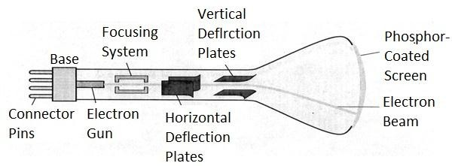
Display devices
Display devices are also known as output devices.
Most commonly used output device in a graphics system is a video monitor.
Cathode-ray-tubes

Slide 9
Fig. 1.1: - Cathode ray tube.
It is an evacuated glass tube.
An electron gun at the rear of the tube produce a beam of electrons which is directed towards the screen of the tube by a high voltage typically 15000 to 20000 volts
Inner side screen is coated with phosphor substance which gives light when it is stroked bye electrons.
Control grid controls velocity of electrons before they hit the phosphor.
The control grid voltage determines how many electrons are actually in the electron beam. The negative the control voltage is the fewer the electrons that pass through the grid.
Thus control grid controls Intensity of the spot where beam strikes the screen.
The focusing system concentrates the electron beam so it converges to small point when hits the phosphor coating.
Deflection system directs beam which decides the point where beam strikes the screen.
Deflection system of the CRT consists of two pairs of parallel plates which are vertical and horizontal deflection plates.
Voltage applied to vertical and horizontal deflection plates is control vertical and horizontal deflection respectively.
There are two techniques used for producing images on the CRT screen:

Slide 10
Refresh CRT • Beam of electrons hit phosphor-coated screen, light emitted by phosphor • Direct electron beam to the same screen repeatedly, keeping phosphor activated • The frequency at which a picture is redrawn on the screen is referred to as the “refresh rate” • The maximum number of points that can be displayed on a CRT is referred to as the “resolution” • Display principle – Raster Scan Display Principle – Random Scan Display Principle

Slide 11
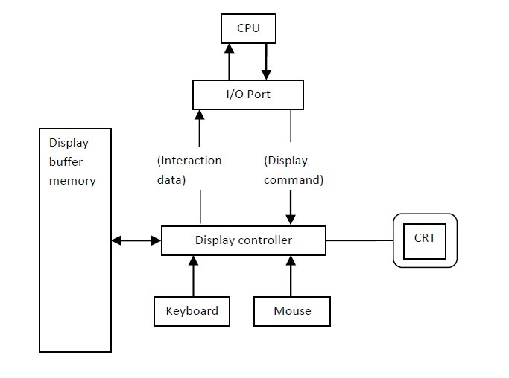
Vector scan/Random scan display.
Raster scan display.
Vector scan/Random scan display

Slide 12
Vector scan display directly traces out only the desired lines on CRT.
If we want line between point p1 & p2 then we directly drive the beam deflection circuitry which focus beam directly from point p1 to p2.
If we do not want to display line from p1 to p2 and just move then we can blank the beam as we move it.
To move the beam across the CRT, the information about both magnitude and direction is required. This information is generated with the help of vector graphics generator.
Fig. 1.2 shows architecture of vector display. It consists of display controller, CPU, display buffer memory and CRT.
Display controller is connected as an I/O peripheral to the CPU.
Display buffer stores computer produced display list or display program.
The Program contains point & line plotting commands with end point co-ordinates as well as character plotting commands.
Display controller interprets command and sends digital and point co-ordinates to a vector generator.
Vector generator then converts the digital co-ordinate value to analog voltages for beam deflection circuits that displace an electron beam which points on the CRT’s screen.
In this technique beam is deflected from end point to end point hence this techniques is also called random scan.
We know as beam strikes phosphors coated screen it emits light but that light decays after few milliseconds and therefore it is necessary to repeat through the display list to refresh the screen at least 30 times per second to avoid flicker.
As display buffer is used to store display list and used to refreshing, it is also called refresh buffer.

Slide 13
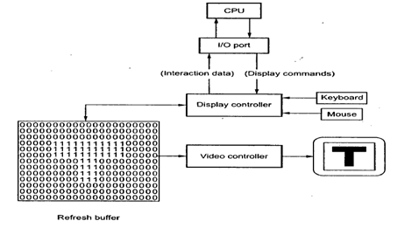
Raster scan display

Slide 14
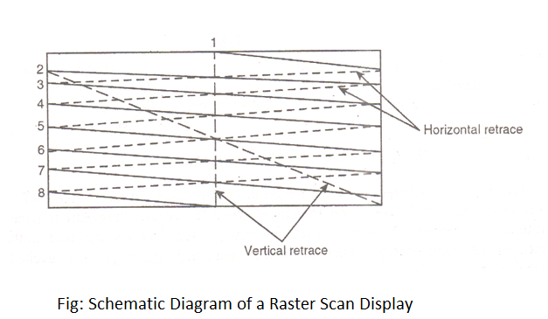
shows the architecture of Raster display. It consists of display controller, CPU, video controller, refresh buffer, keyboard, mouse and CRT.
The display image is stored in the form of 1’s and 0’s in the refresh buffer.
The video controller reads this refresh buffer and produces the actual image on screen.
It will scan one line at a time from top to bottom & then back to the top.

Slide 15
In this method the horizontal and vertical deflection signals are generated to move the beam all over the screen in a pattern shown in fig. 1.4.
Here beam is swept back & forth from left to the right.
When beam is moved from left to right it is ON.
When beam is moved from right to left it is OFF and process of moving beam from right to left after completion of row is known as Horizontal Retrace.
When beam is reach at the bottom of the screen. It is made OFF and rapidly retraced back to the top left to start again and process of moving back to top is known as Vertical Retrace.
The screen image is maintained by repeatedly scanning the same image. This process is known as
Refreshing of Screen.
In raster scan displays a special area of memory is dedicated to graphics only. This memory is called
Frame Buffer.
Frame buffer holds set of intensity values for all the screen points.
That intensity is retrieved from frame buffer and display on screen one row at a time.
Each screen point referred as pixel or Pel (Picture Element).
Each pixel can be specified by its row and column numbers.
It can be simply black and white system or color system.
In simple black and white system each pixel is either ON or OFF, so only one bit per pixel is needed.
Additional bits are required when color and intensity variations can be displayed up to 24-bits per pixel are included in high quality display systems.
On a black and white system with one bit per pixel the frame buffer is commonly called a Bitmap. And for systems with multiple bits per pixel, the frame buffer is often referred as a Pixmap.

Slide 16
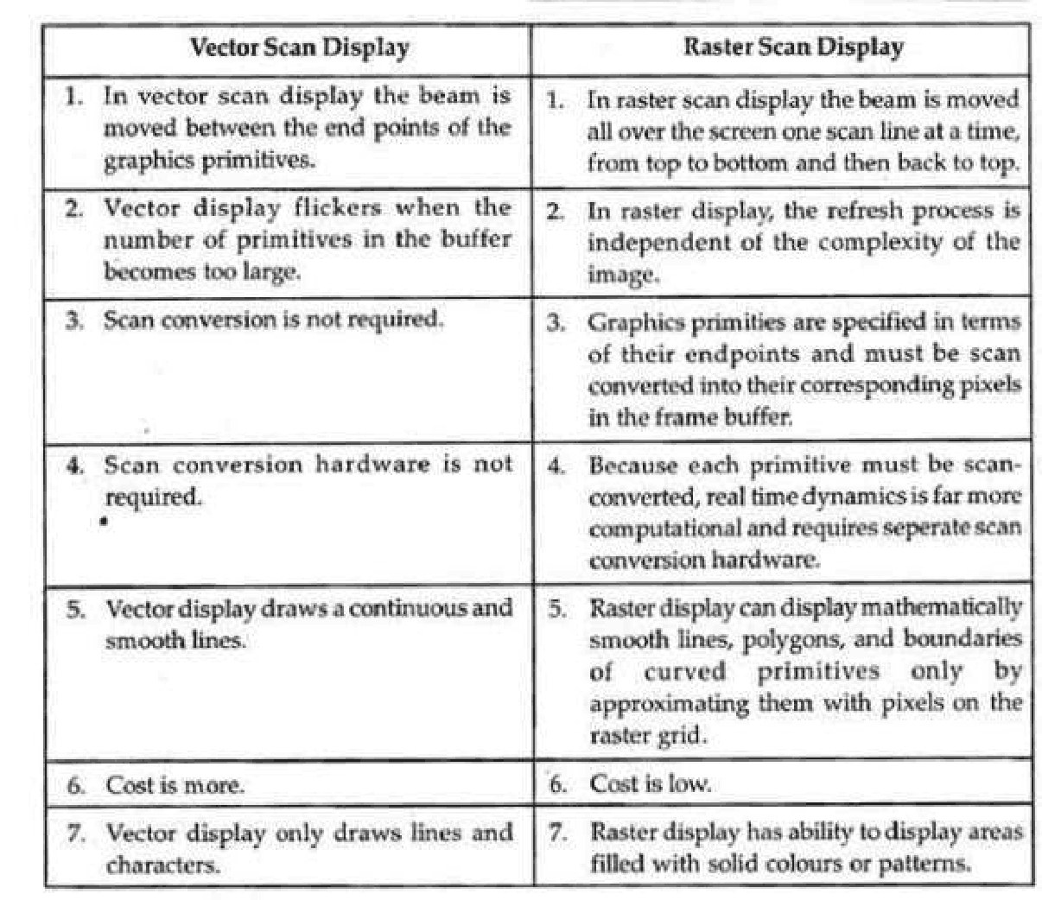

Slide 17
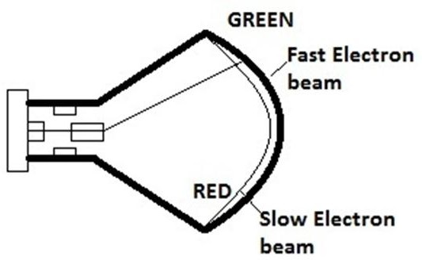
Unit-1 – Basics of Computer Graphics
Color CRT monitors
A CRT monitors displays color pictures by using a combination of phosphors that emit different colored light.
It produces range of colors by combining the light emitted by different phosphors.
There are two basic techniques for color display:
Beam-penetration technique
Shadow-mask technique
Beam-penetration technique

Slide 18
This technique is used with random scan monitors.
In this technique inside of CRT coated with two phosphor layers usually red and green. The outer layer of red and inner layer of green phosphor.
The color depends on how far the electron beam penetrates into the phosphor layer.
A beam of fast electron penetrates more and excites inner green layer while slow electron excites outer red layer.
At intermediate beam speed we can produce combination of red and green lights which emit additional two colors orange and yellow.
The beam acceleration voltage controls the speed of the electrons and hence color of pixel.
It is a low cost technique to produce color in random scan monitors.
It can display only four colors.
Quality of picture is not good compared to other techniques.

Slide 19
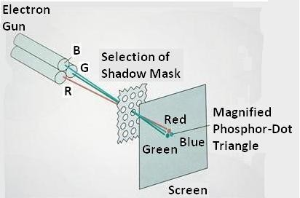
Shadow-mask technique

Slide 20
It produces wide range of colors as compared to beam-penetration technique.
This technique is generally used in raster scan displays. Including color TV.
In this technique CRT has three phosphor color dots at each pixel position. One dot for red, one for green and one for blue light. This is commonly known as Dot Triangle.
Here in CRT there are three electron guns present, one for each color dot. And a shadow mask grid just behind the phosphor coated screen.
The shadow mask grid consists of series of holes aligned with the phosphor dot pattern.
Three electron beams are deflected and focused as a group onto the shadow mask and when they pass through a hole they excite a dot triangle.
In dot triangle three phosphor dots are arranged so that each electron beam can activate only its corresponding color dot when it passes through the shadow mask.
A dot triangle when activated appears as a small dot on the screen which has color of combination of three small dots in the dot triangle.
By changing the intensity of the three electron beams we can obtain different colors in the shadow mask CRT.

Slide 21
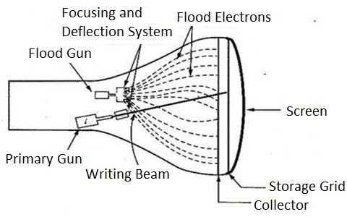
Direct-view storage tubes (DVST)

Slide 22
Fig. 1.7: - Direct-view storage tube.
In raster scan display we do refreshing of the screen to maintain a screen image.
DVST gives alternative method for maintaining the screen image.
DVST uses the storage grid which stores the picture information as a charge distribution just behind the phosphor coated screen.
DVST consists two electron guns a primary gun and a flood gun.
A primary gun stores the picture pattern and the flood gun maintains the picture display.
A primary gun emits high speed electrons which strike on the storage grid to draw the picture pattern.
As electron beam strikes on the storage grid with high speed, it knocks out electrons from the storage grid keeping the net positive charge.
The knocked out electrons are attracted towards the collector.
The net positive charge on the storage grid is nothing but the picture pattern.
The continuous low speed electrons from flood gun pass through the control grid and are attracted to the positive charged area of the storage grid.

Slide 23
The low speed electrons then penetrate the storage grid and strike the phosphor coating without affecting the positive charge pattern on the storage grid.
During this process the collector just behind the storage grid smooth out the flow of flood electrons.
Advantage of DVST
Refreshing of CRT is not required.
Very complex pictures can be displayed at very high resolution without flicker.
Flat screen.
Disadvantage of DVST
They do not display color and are available with single level of line intensity.
For erasing it is necessary to removal of charge on the storage grid so erasing and redrawing process take several second.
Erasing selective part of the screen cannot be possible.
Cannot used for dynamic graphics application as on erasing it produce unpleasant flash over entire screen.
It has poor contrast as a result of the comparatively low accelerating potential applied to the flood electrons.
The performance of DVST is somewhat inferior to the refresh CRT.

Slide 24
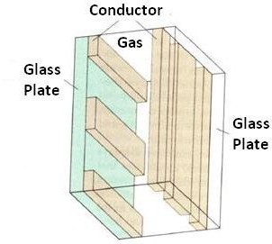
Flat Panel Display
The term flat panel display refers to a class of video device that have reduced volume, weight & power requirement compared to a CRT.
As flat panel display is thinner than CRTs, we can hang them on walls or wear on our wrists.
Since we can even write on some flat panel displays they will soon be available as pocket notepads.
We can separate flat panel display in two categories:
Emissive displays: - the emissive display or emitters are devices that convert electrical energy into light. For Ex. Plasma panel, thin film electroluminescent displays and light emitting diodes.
Non emissive displays: - non emissive display or non emitters use optical effects to convert sunlight or light from some other source into graphics patterns. For Ex. LCD (Liquid Crystal Display).
Plasma Panels displays

Slide 25
This is also called gas discharge displays.
It is constructed by filling the region between two glass plates with a mixture of gases that usually includes neon.
A series of vertical conducting ribbons is placed on one glass panel and a set of horizontal ribbon is built into the other glass panel.
Firing voltage is applied to a pair of horizontal and vertical conductors cause the gas at the intersection of the two conductors to break down into glowing plasma of electrons and ions.
Picture definition is stored in a refresh buffer and the firing voltages are applied to refresh the pixel positions, 60 times per second.
Alternating current methods are used to provide faster application of firing voltages and thus brighter displays.
Separation between pixels is provided by the electric field of conductor.
One disadvantage of plasma panels is they were strictly monochromatic device that means shows only one color other than black like black and white.

Slide 26
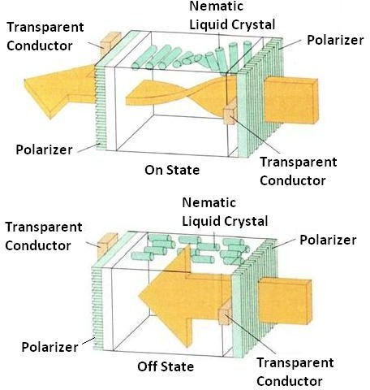
Liquid Crystal Display (LCD)

Slide 27
Fig. 1.10: - Light twisting shutter effect used in design of most LCD.
It is generally used in small system such as calculator and portable laptop.
This non emissive device produce picture by passing polarized light from the surrounding or from an internal light source through liquid crystal material that can be aligned to either block or transmit the light.
The liquid crystal refreshes to fact that these compounds have crystalline arrangement of molecules then also flows like liquid.
It consists of two glass plates each with light polarizer at right angles to each other sandwich the liquid crystal material between the plates.
Rows of horizontal transparent conductors are built into one glass plate, and column of vertical conductors are put into the other plates.
The intersection of two conductors defines a pixel position.
In the ON state polarized light passing through material is twisted so that it will pass through the opposite polarizer.
In the OFF state it will reflect back towards source.
We applied a voltage to the two intersecting conductor to align the molecules so that the light is not twisted.
This type of flat panel device is referred to as a passive matrix LCD.
In active matrix LCD transistors are used at each (x, y) grid point.

Slide 28
Transistor cause crystal to change their state quickly and also to control degree to which the state has been changed.
Transistor can also serve as a memory for the state until it is changed.
So transistor make cell ON for all time giving brighter display then it would be if it had to be refresh periodically
Advantages of LCD display
Low cost.
Low weight.
Small size
Low power consumption.

Slide 29
Light Emitting Diode (LED)
In this display a matrix of multi-color light emitting diode is arranged to form the pixel position in the display. And the picture definition is stored in refresh buffer.
Similar to scan line refreshing of CRT information is read from the refresh buffer and converted to voltage levels that are applied to the diodes to produce the light pattern on the display.

Slide 30
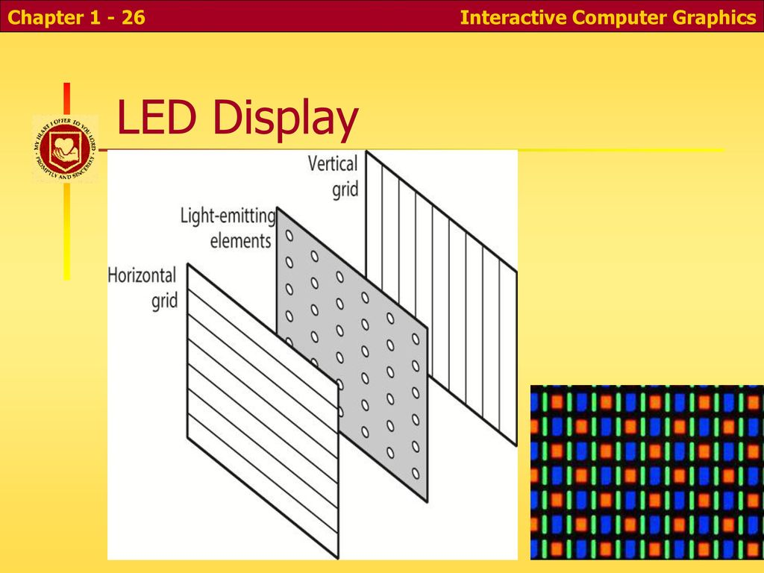

Slide 31
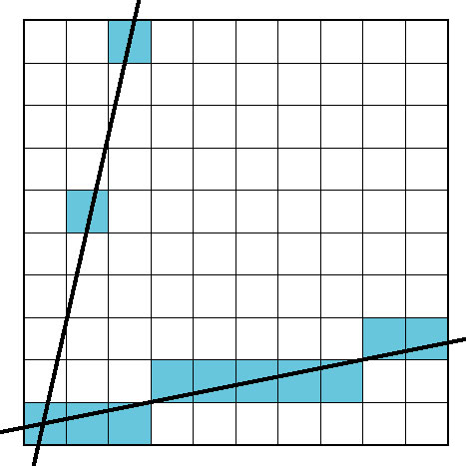
Problem
DDA = for each x plot pixel at closest y
Problems for steep lines

Slide 32
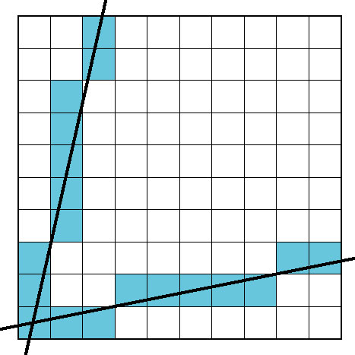
Using Symmetry
Use for 1 ≥ m ≥ 0
For m > 1, swap role of x and y
For each y, plot closest x

Slide 33
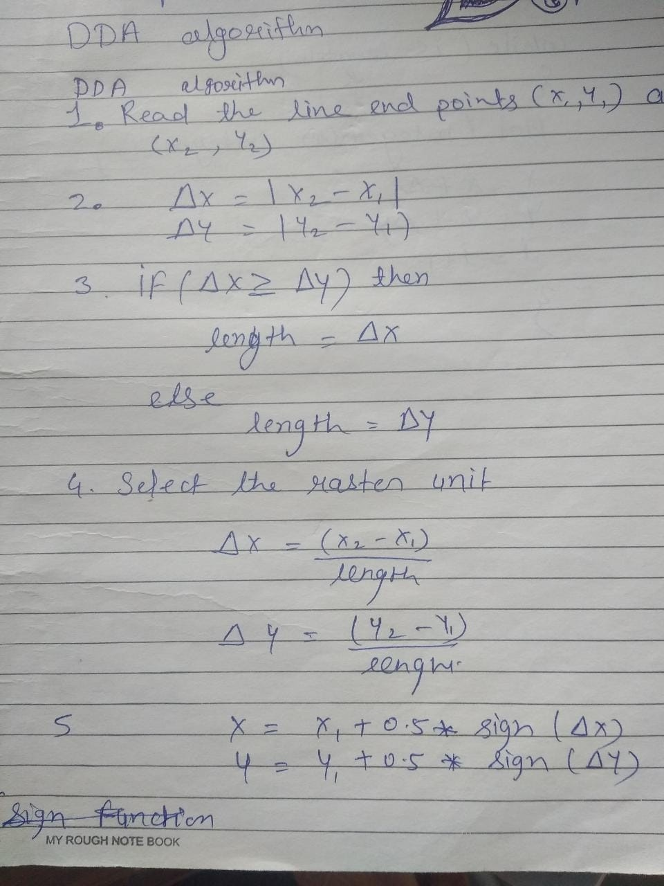

Slide 34
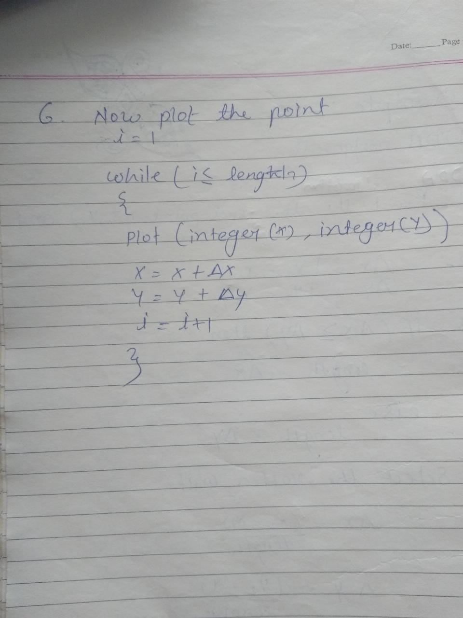

Slide 35
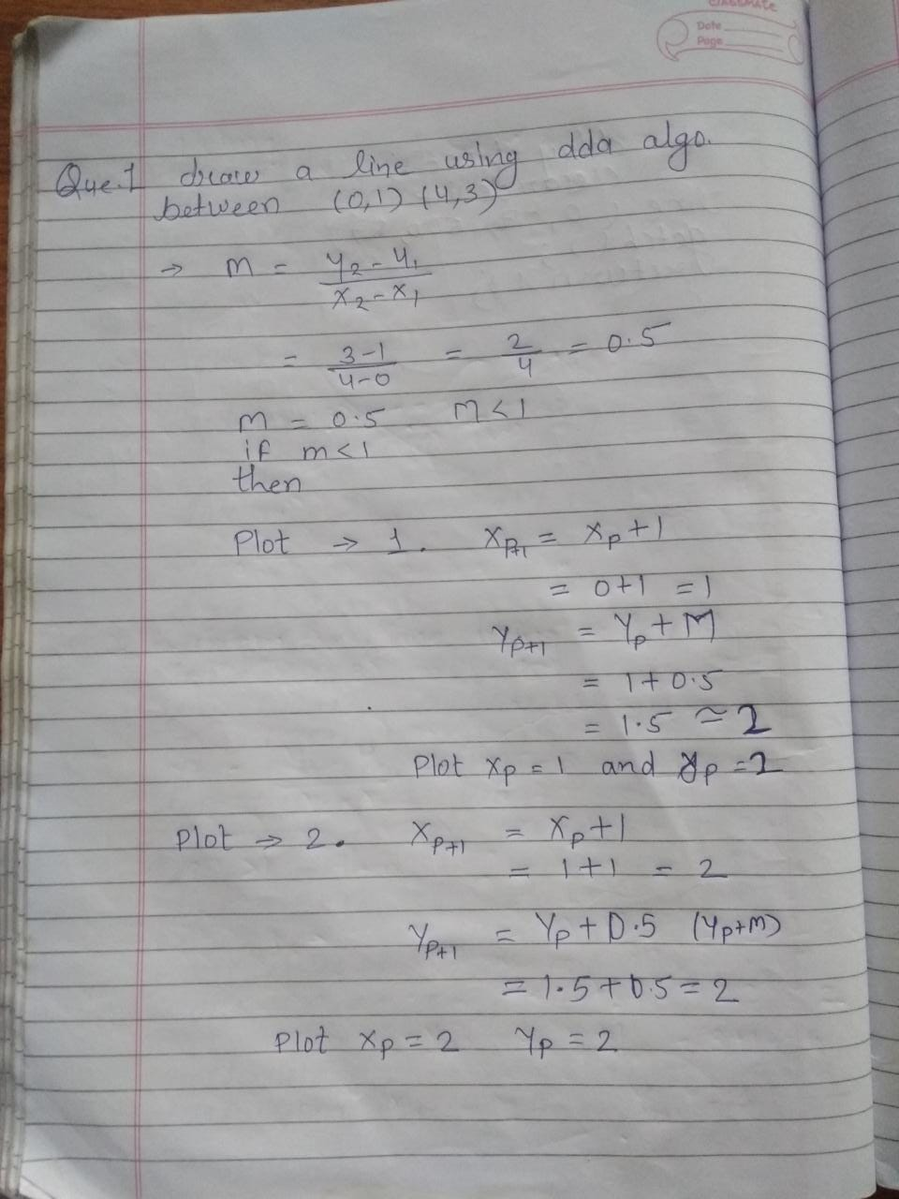

Slide 36
M<1 x=x+1 y=y+m m>1 x=x+ 1/m y=y+1

Slide 37
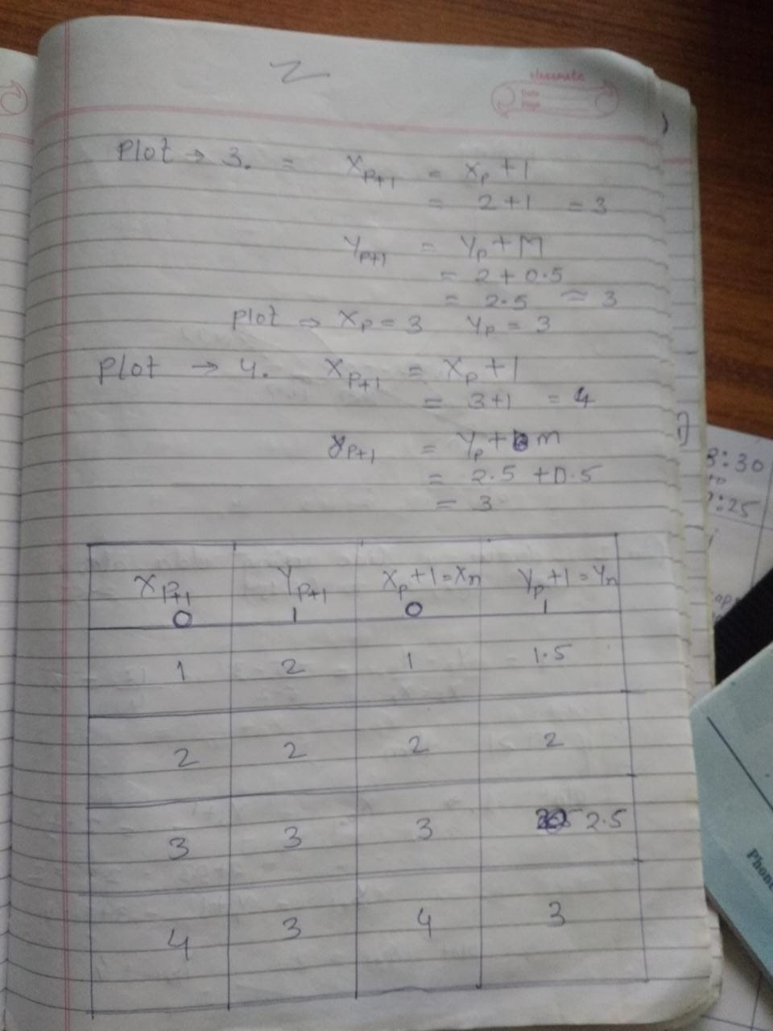
1 | 2 | 1 | 1.5
2 | 2 | 2 | 2
3 | 3 | 3 | 2.5
4 | 3 | 4 | 3

Slide 38
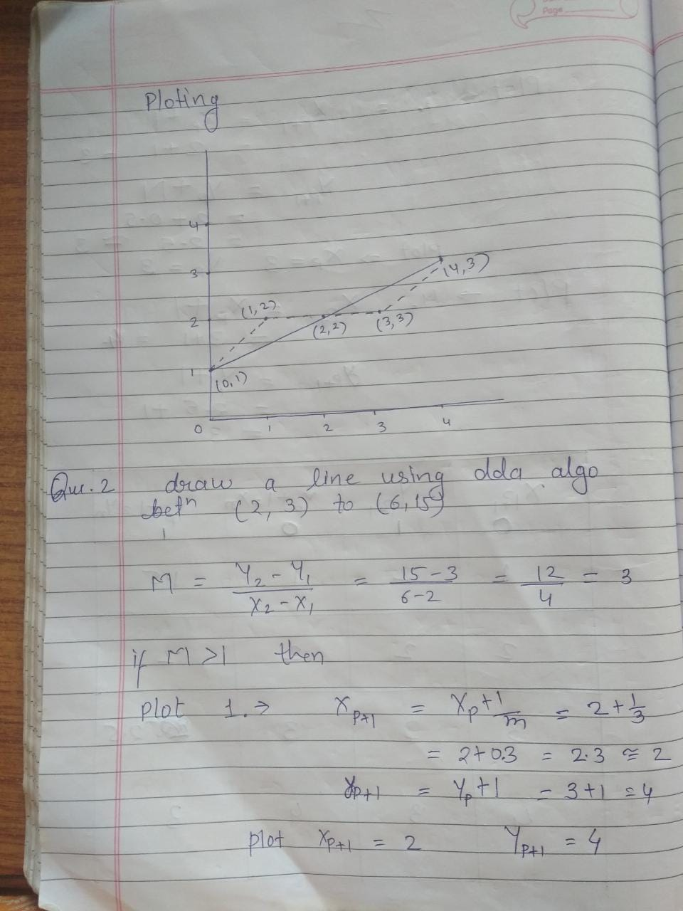

Slide 39
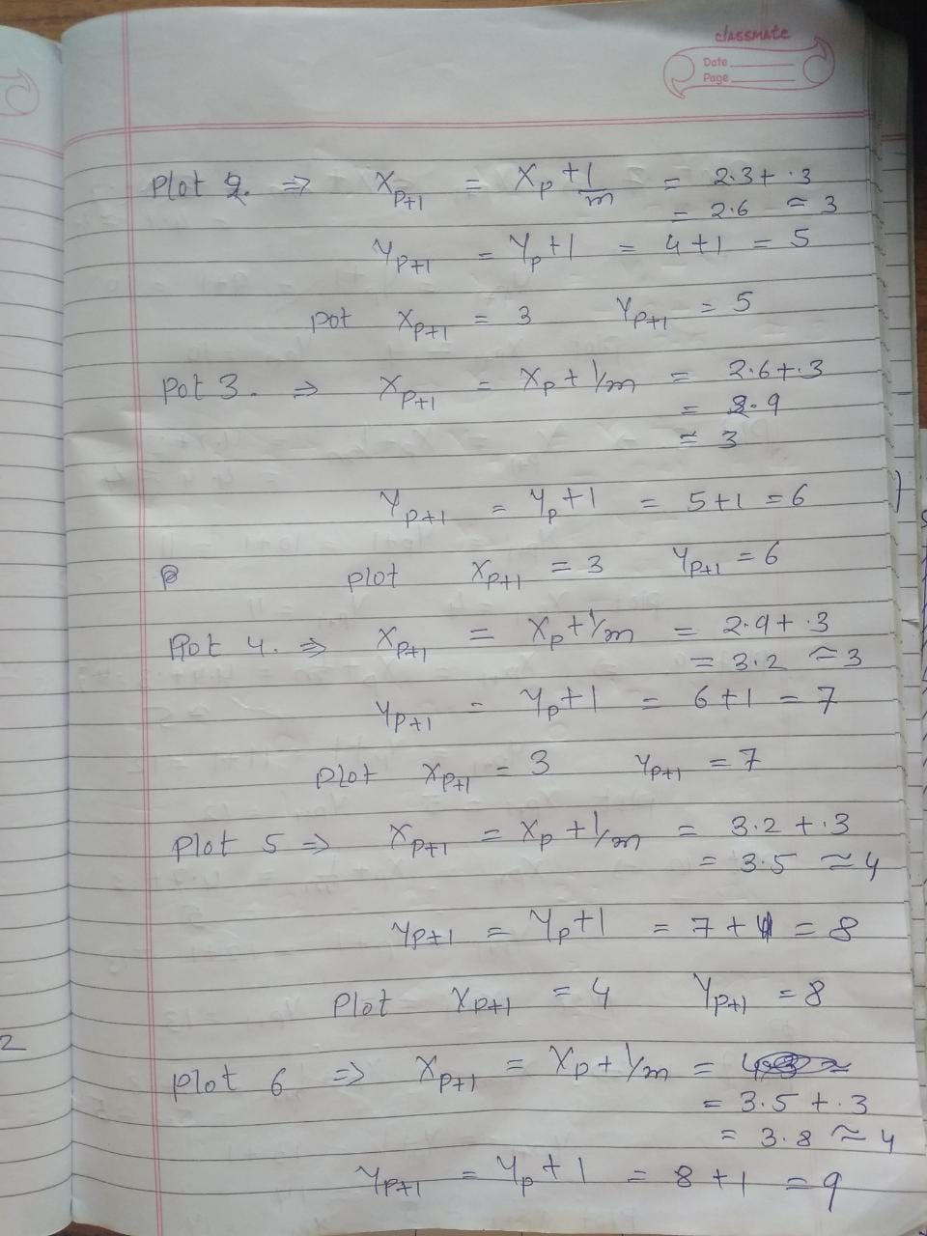

Slide 40
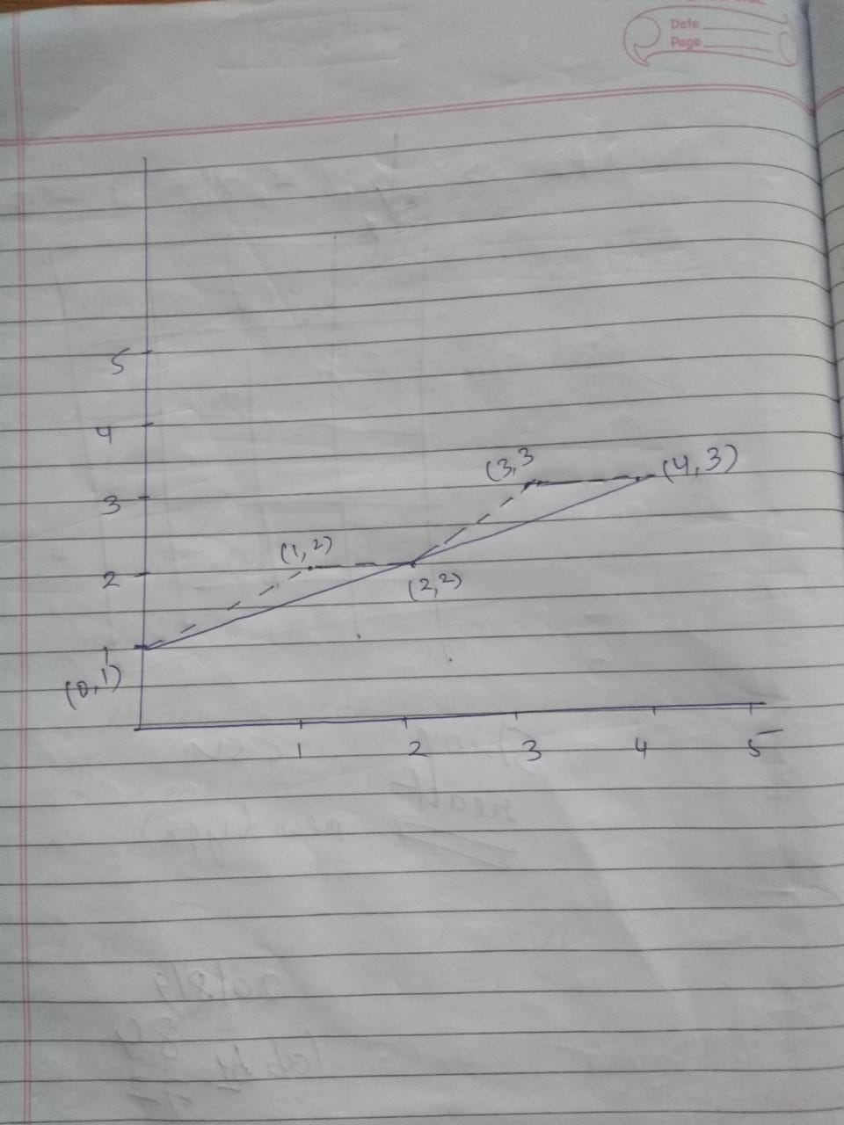

Slide 41
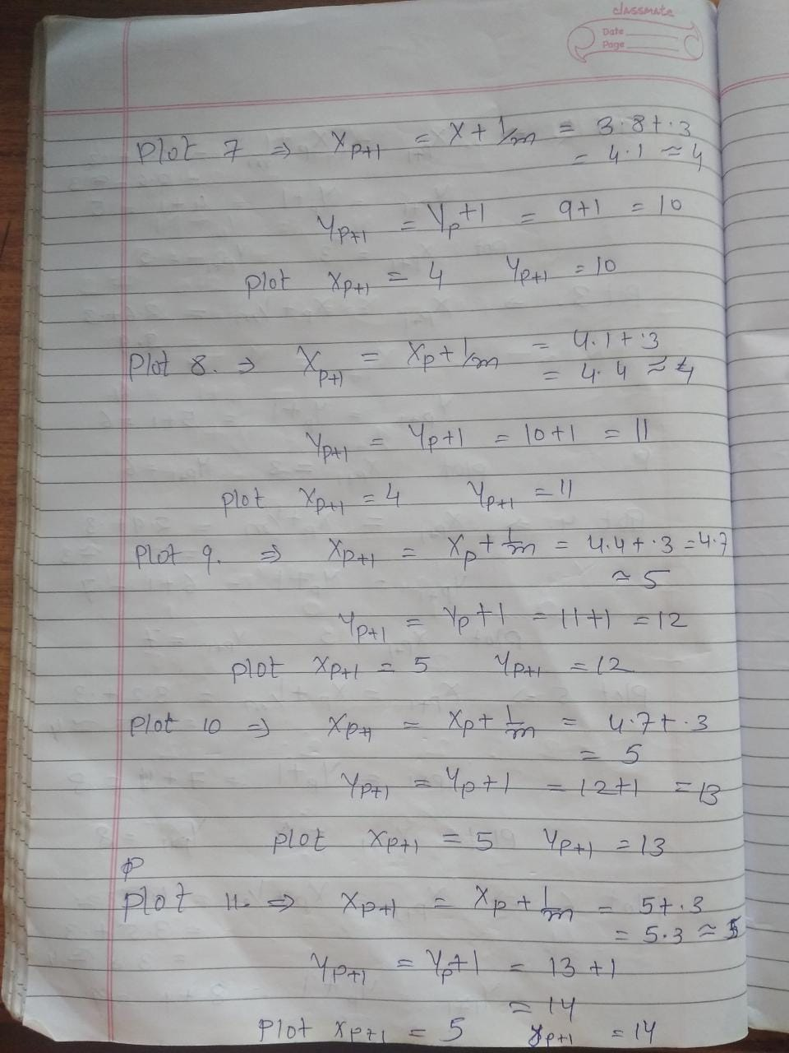

Slide 42
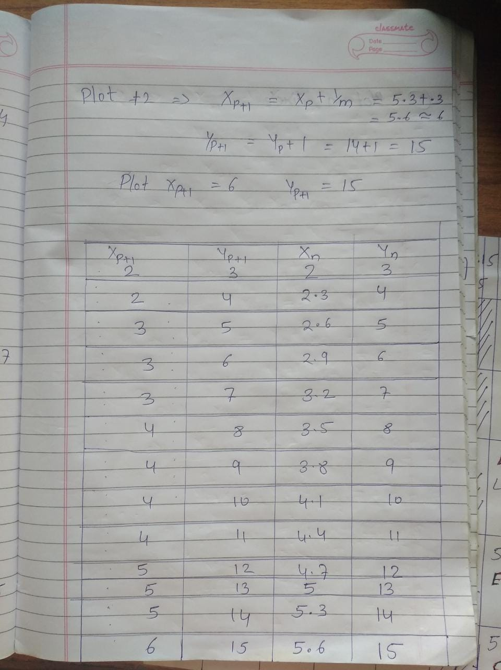

Slide 43
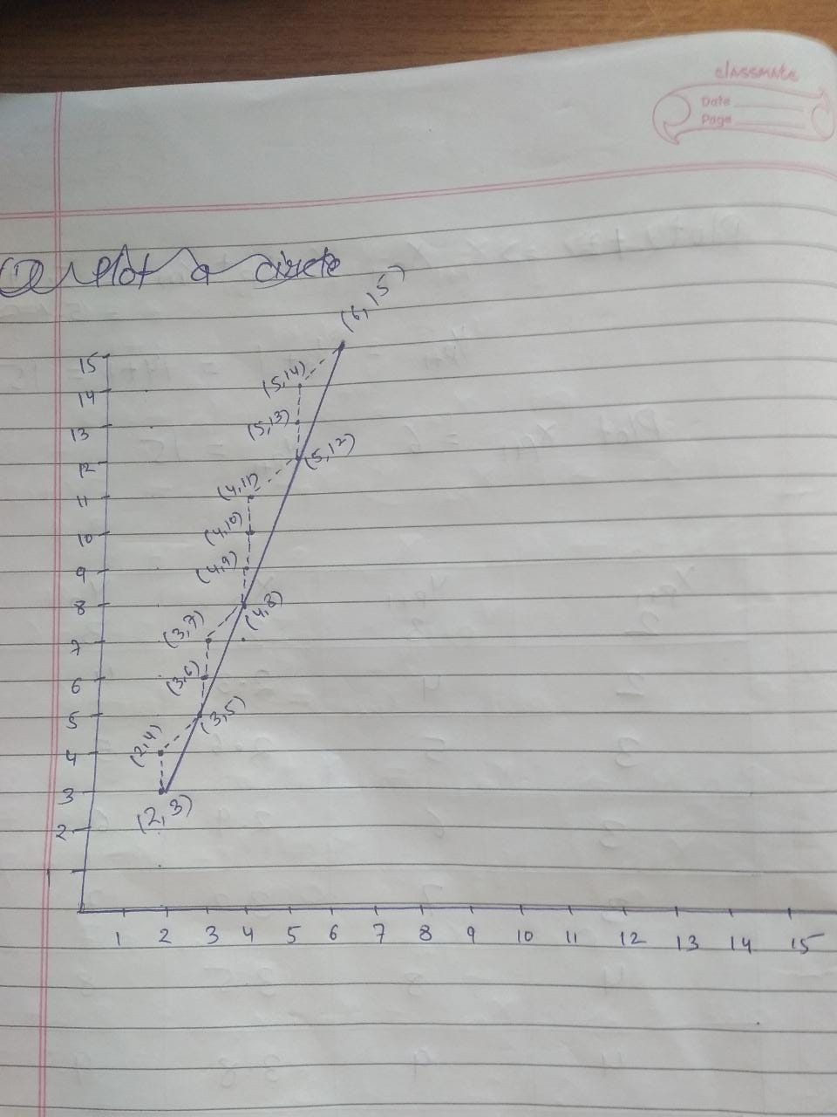

Slide 44
Dy=6 dx=3 m=2 dy=3 dx=6 m=.5
Advantages of DDA algorithm
It is faster algorithm.
It is simple algorithm.
Disadvantage of DDA algorithm
Floating point arithmetic is time consuming.
Poor end point accuracy.

Slide 45
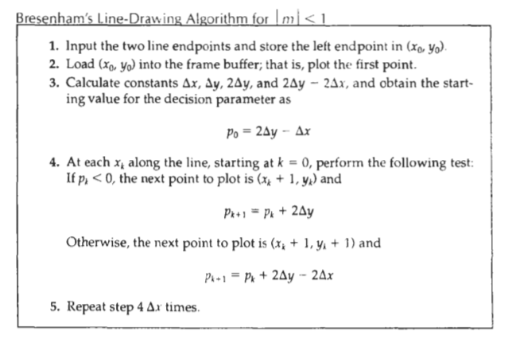

Slide 46
2 | 36 | 41
-4 | 37 | 41
6 | 38 | 42
0 | 39 | 43
-6 | 40 | 43
4 | 41 | 44
-2 | 42 | 44
8 | 43 | 45

Slide 47
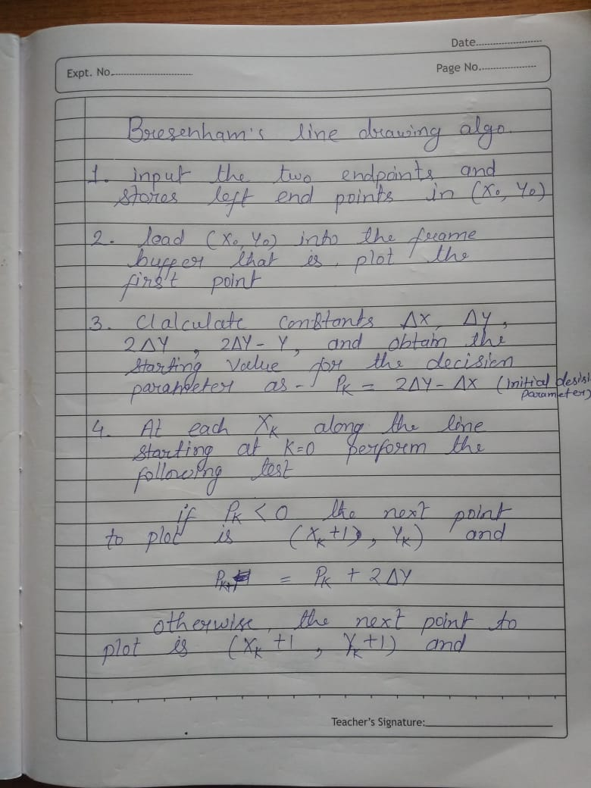

Slide 48
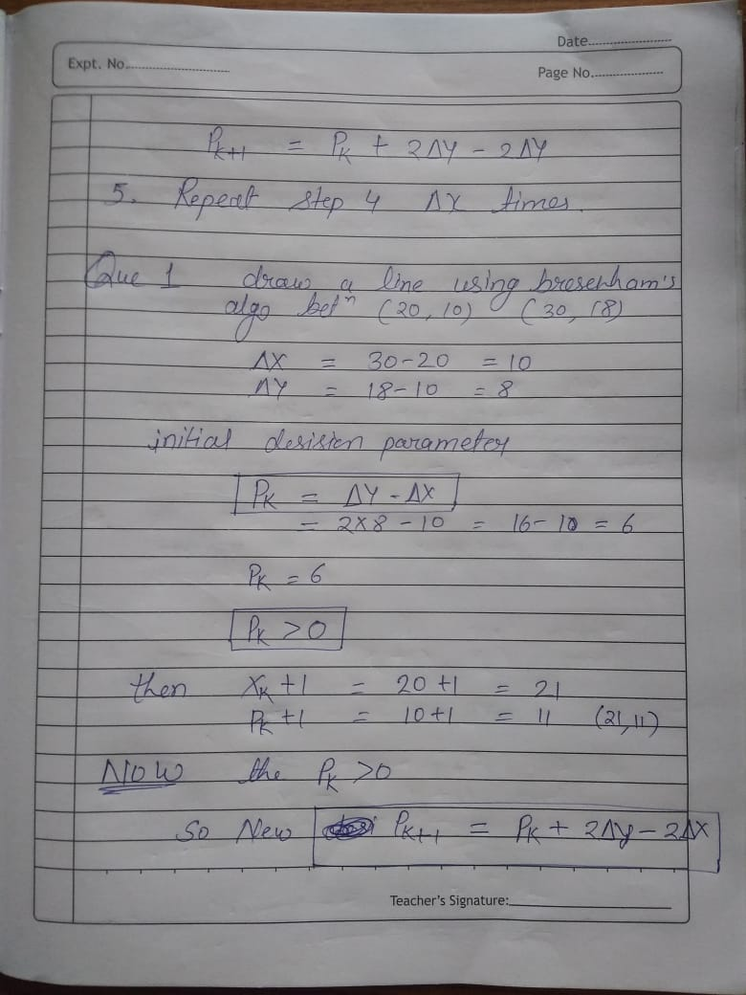
2

Slide 49
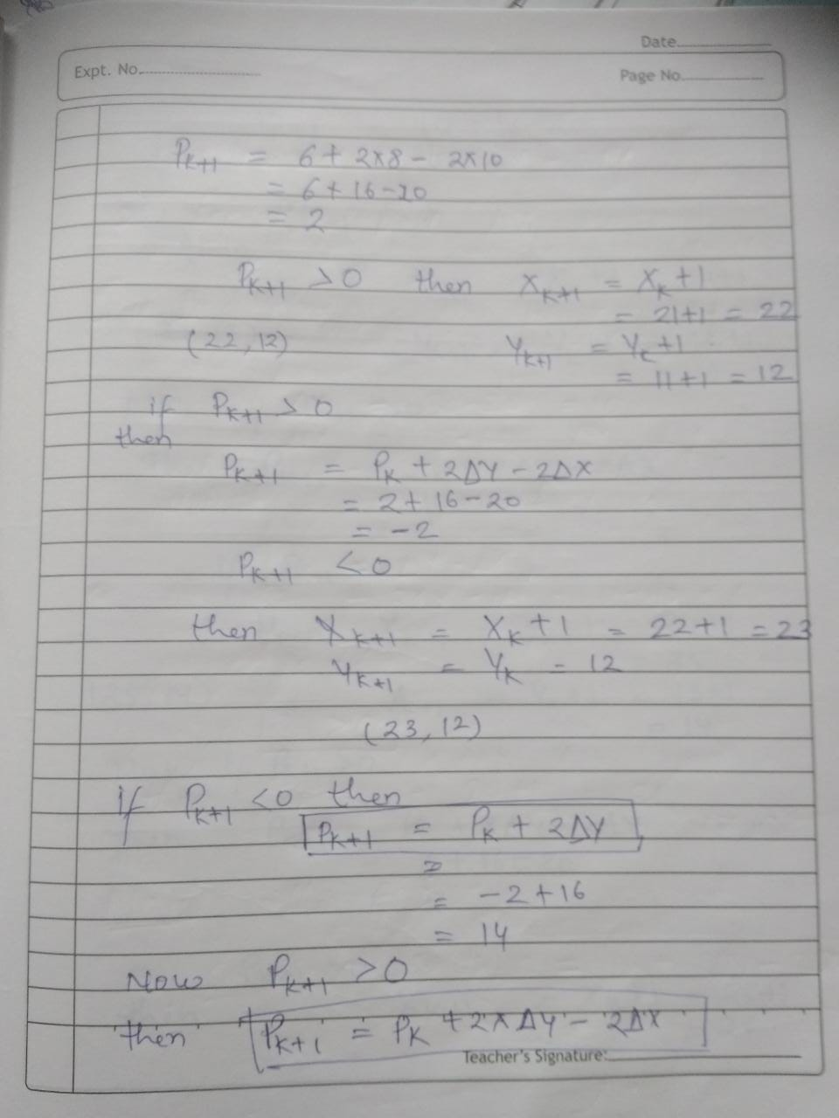

Slide 50
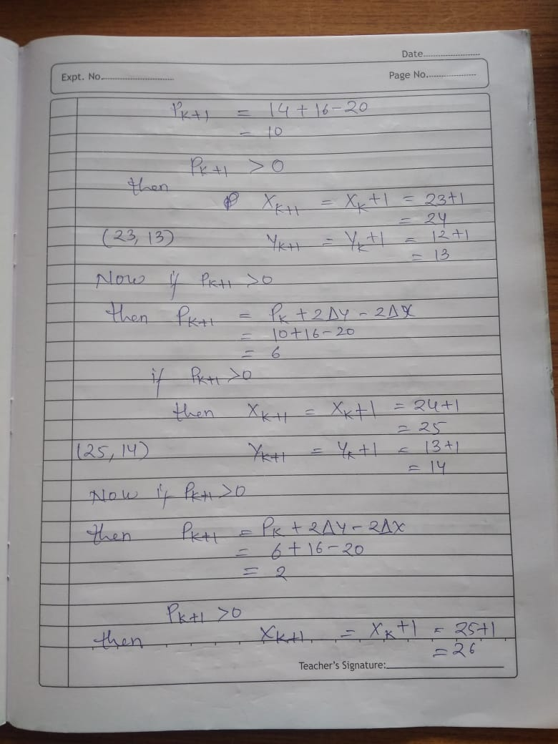

Slide 51
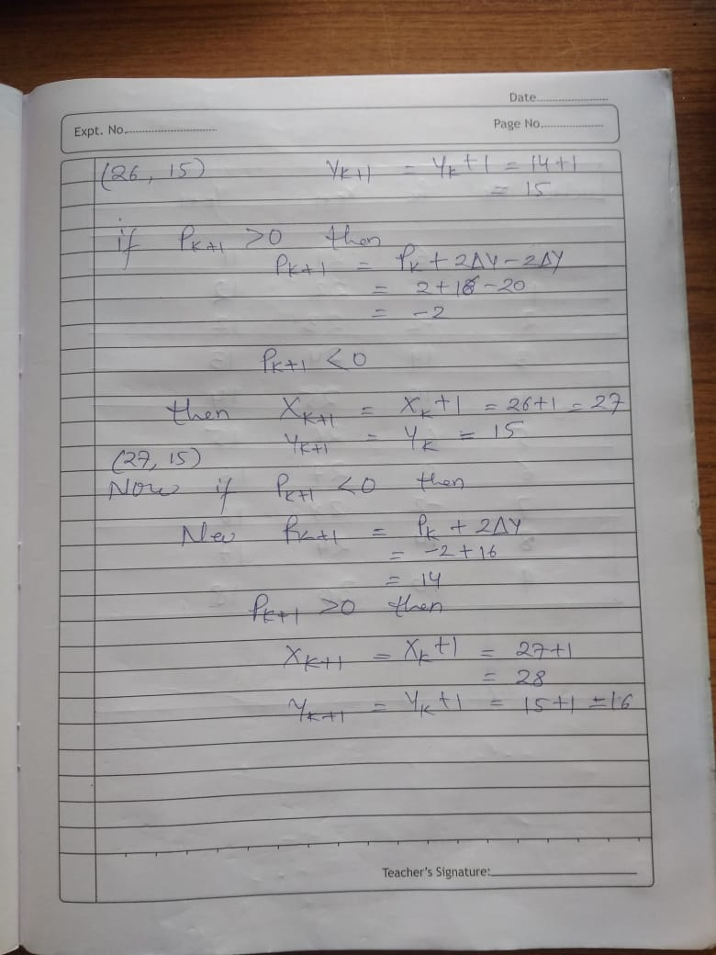

Slide 52
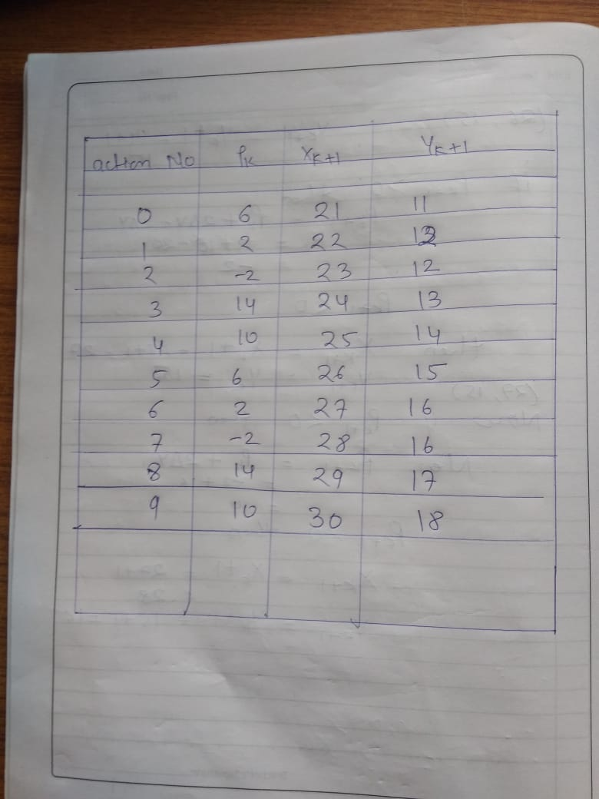

Slide 53
Bresenham’s algo
For m>1
P0= 2dx-dy
If p>0 then (x+1, y+1)
If p<0 then (x, y+1)

Slide 55
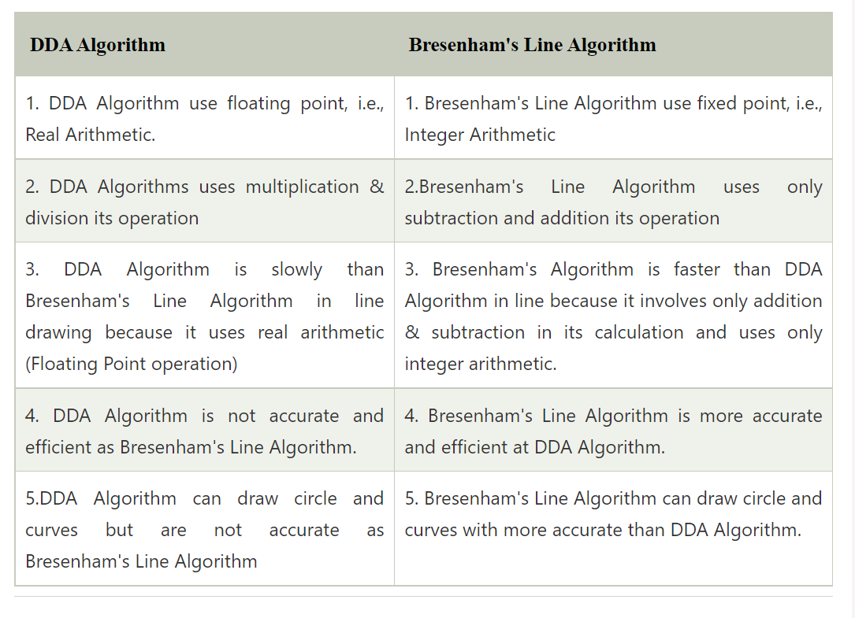

Slide 56
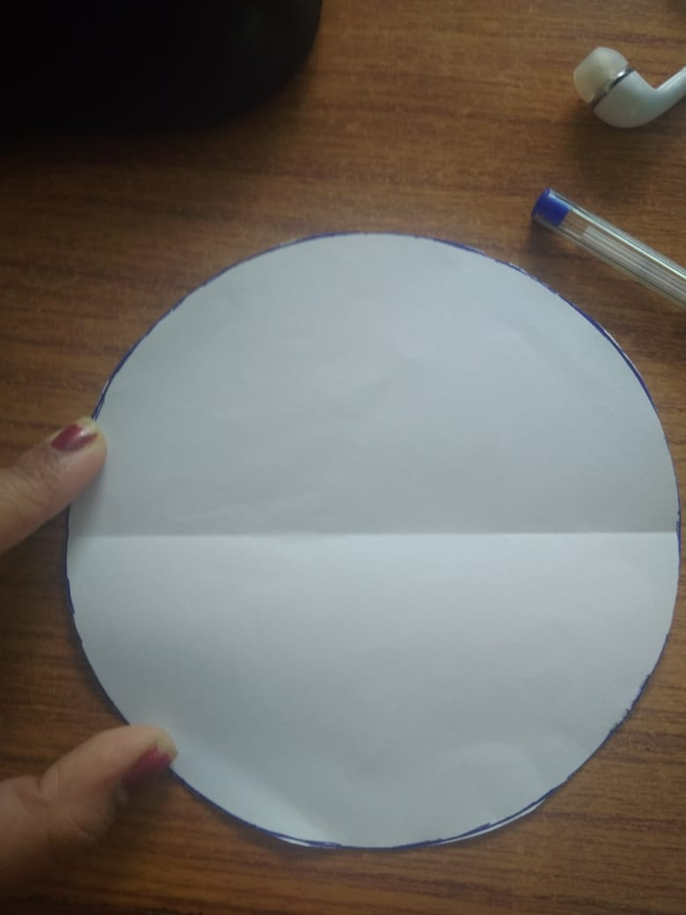

Slide 57
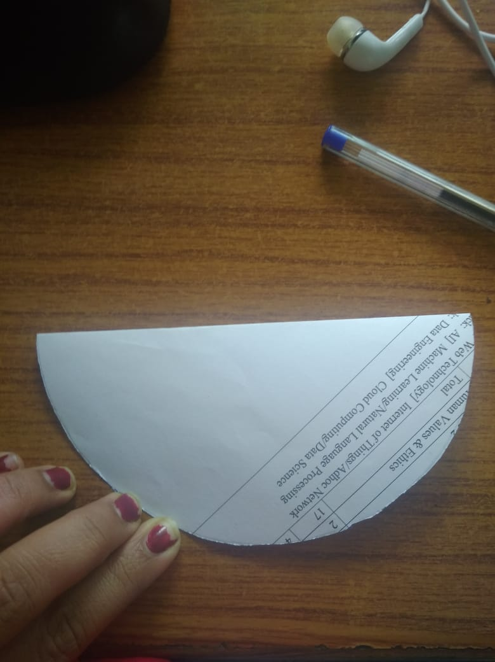

Slide 59
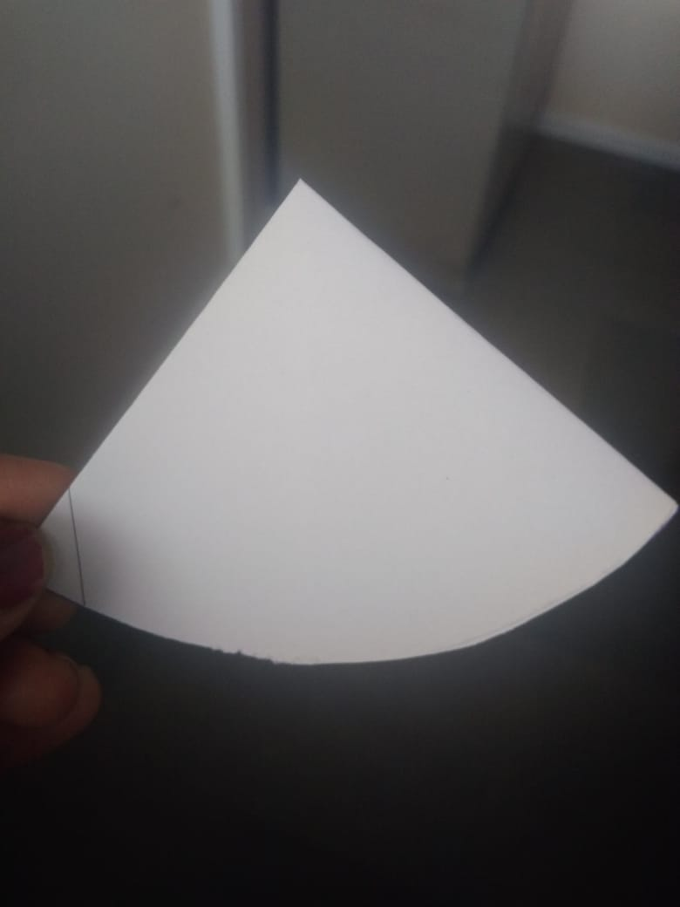

Slide 60
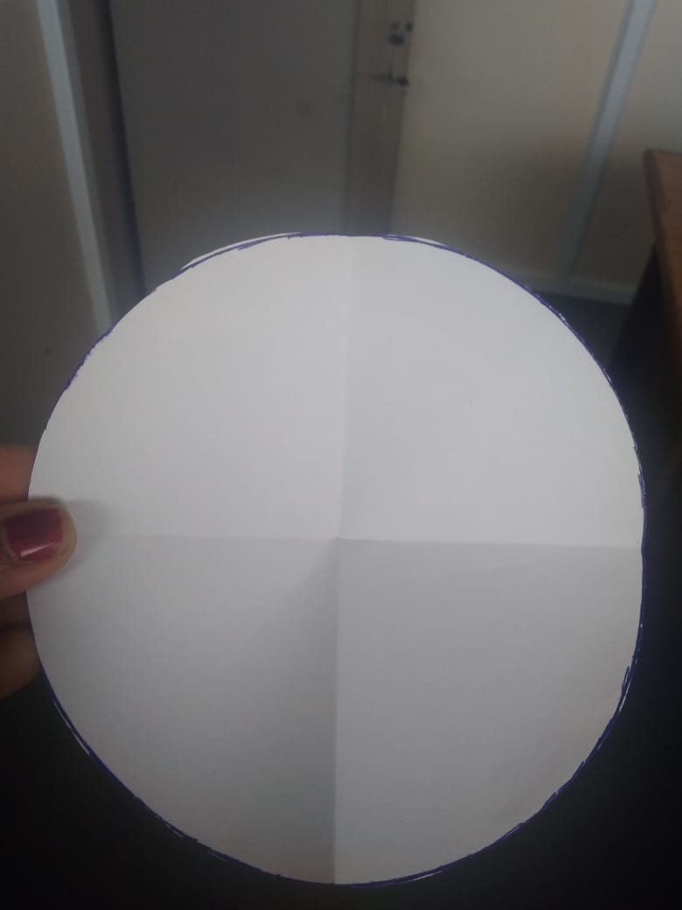

Slide 61
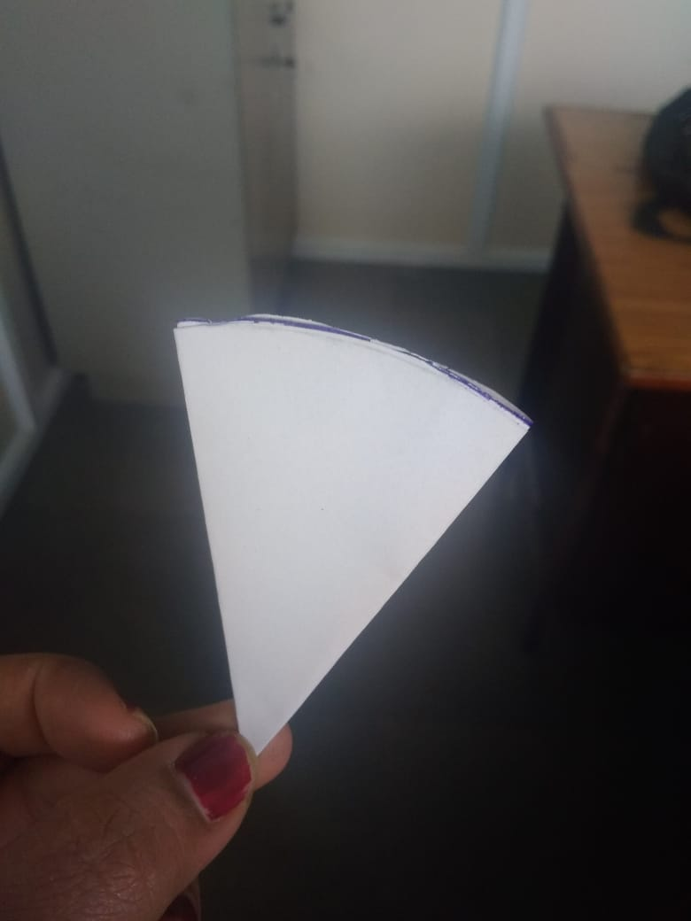

Slide 62
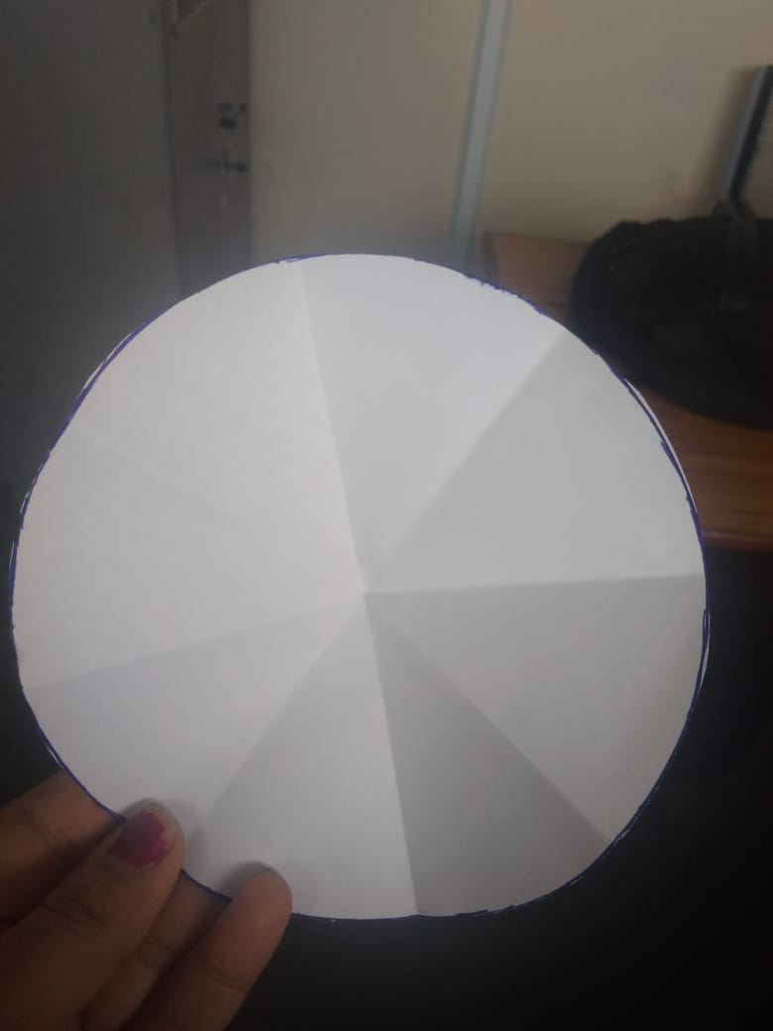

Slide 63
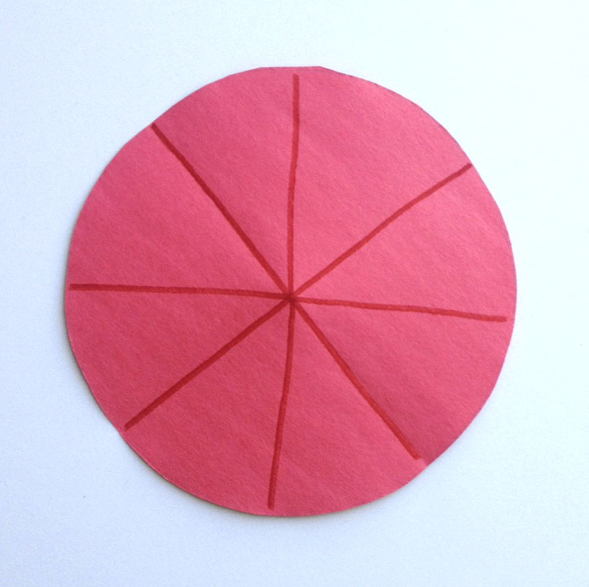

Slide 65
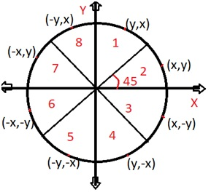

Slide 66
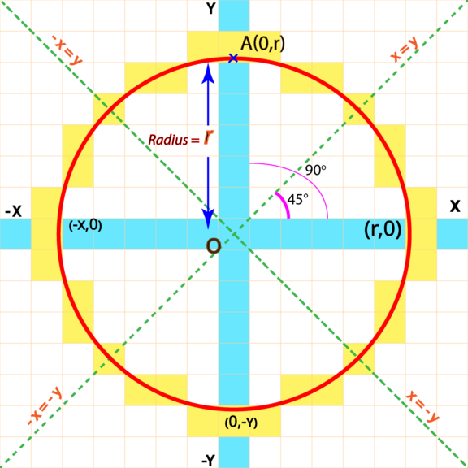

Slide 67
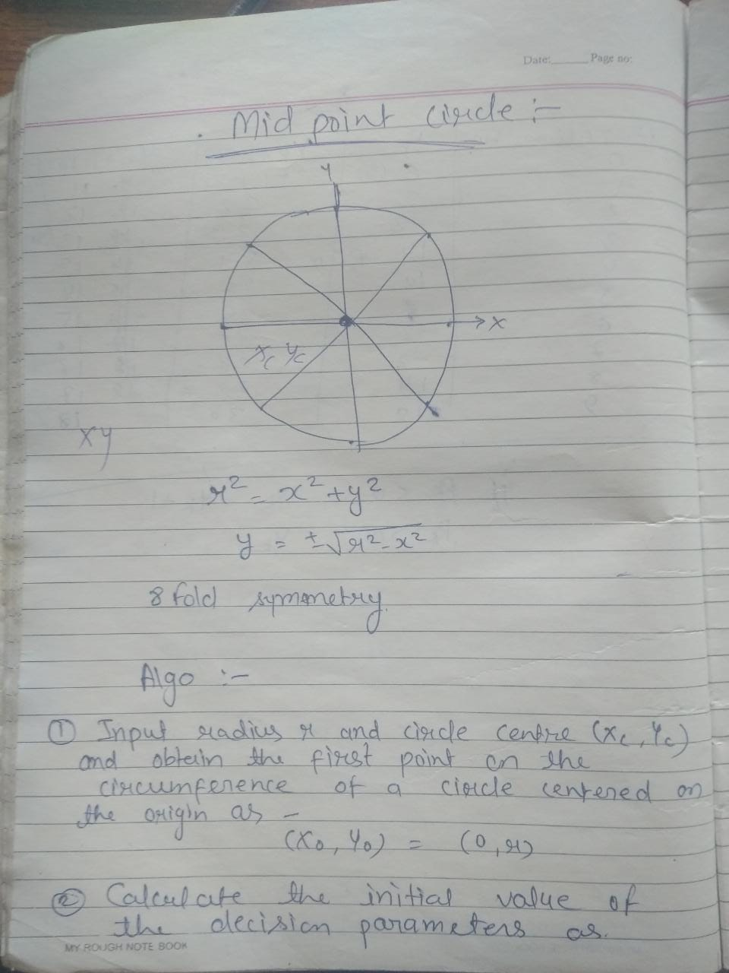

Slide 68
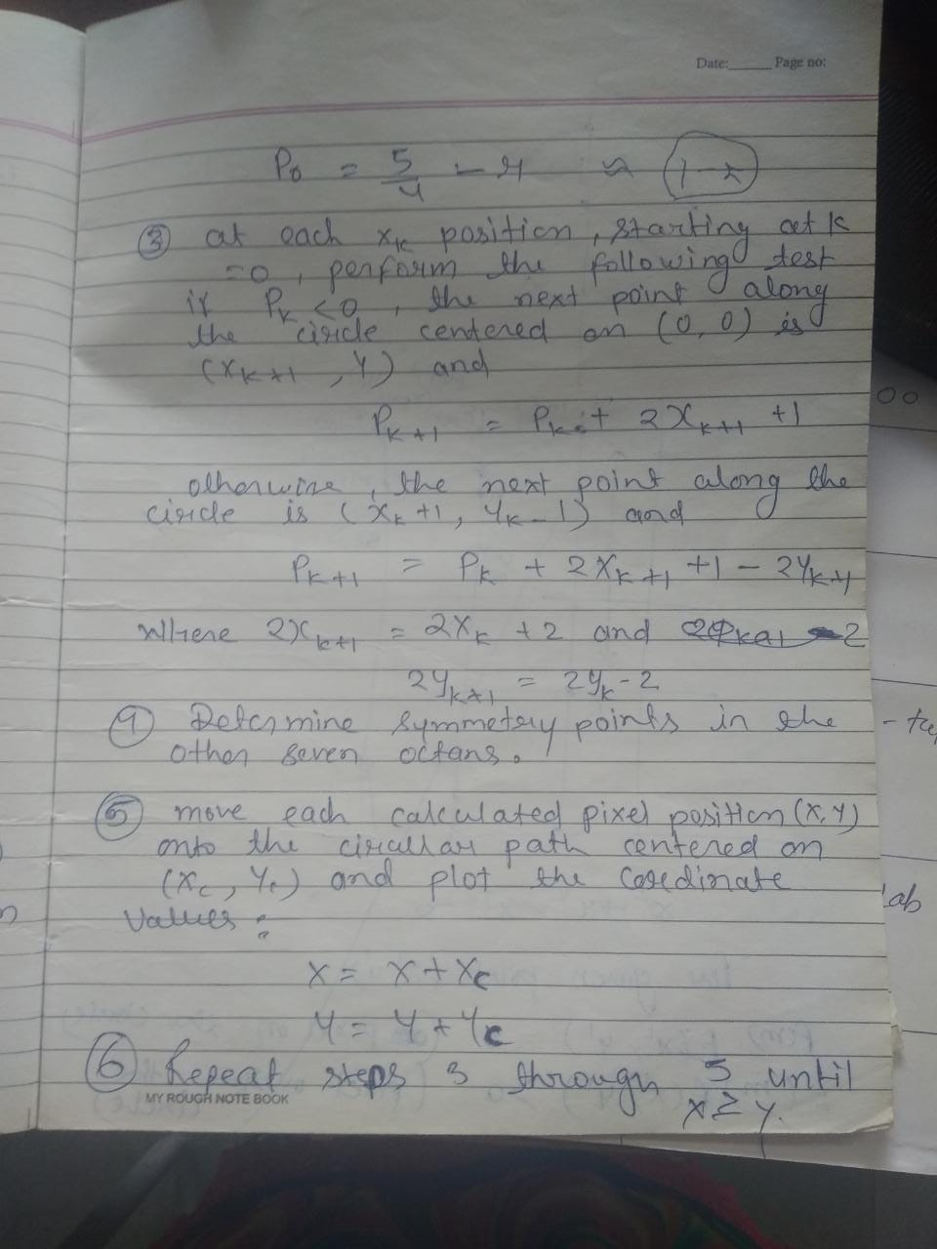

Slide 69
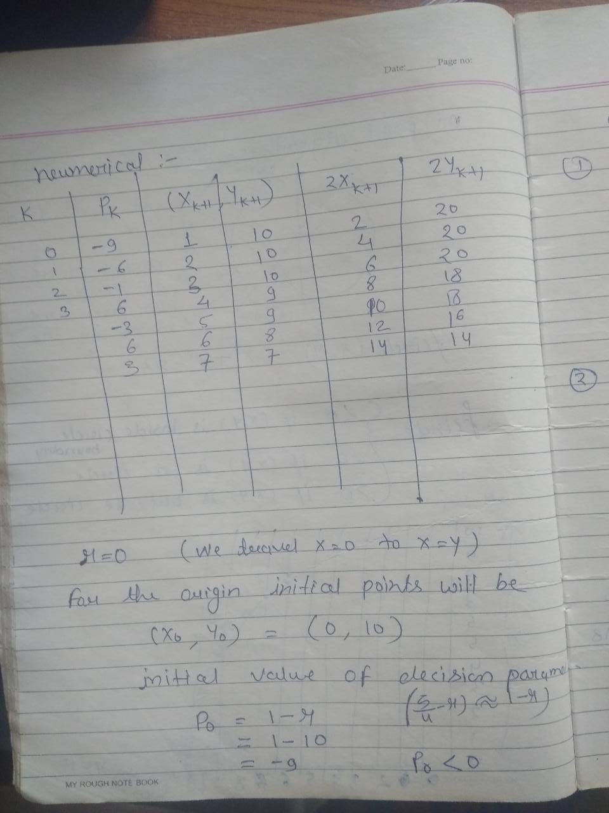

Slide 70
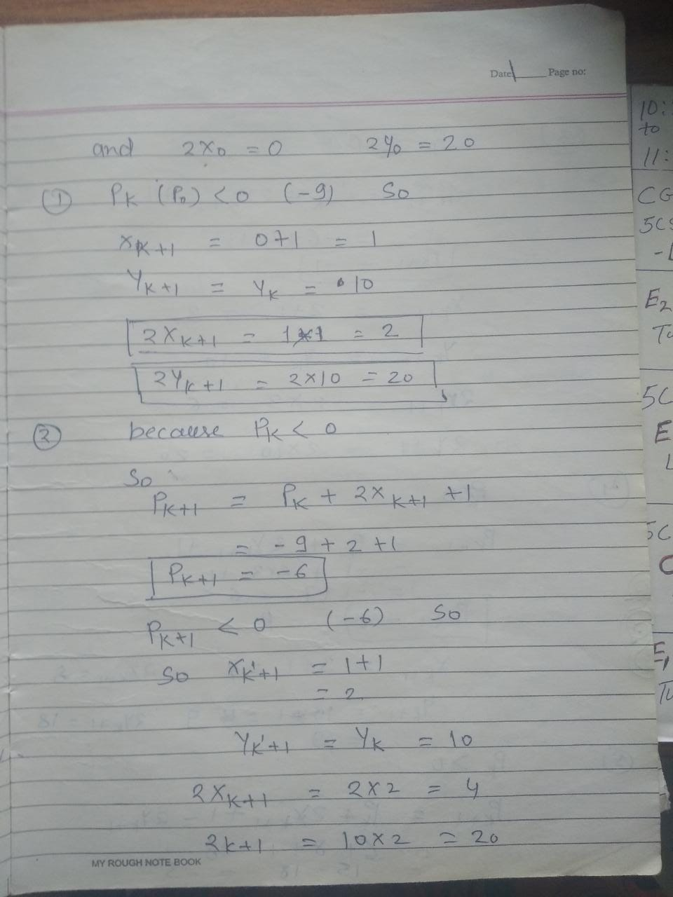

Slide 71
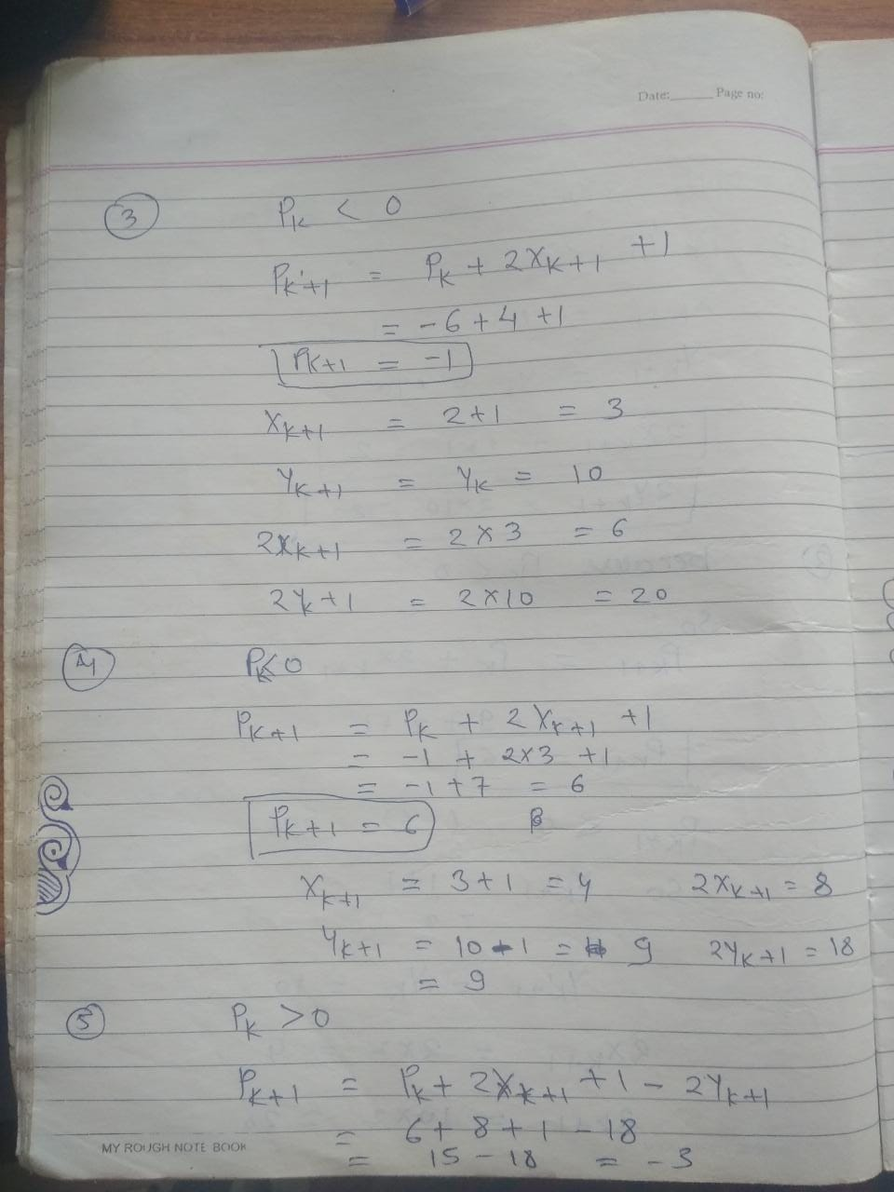

Slide 72
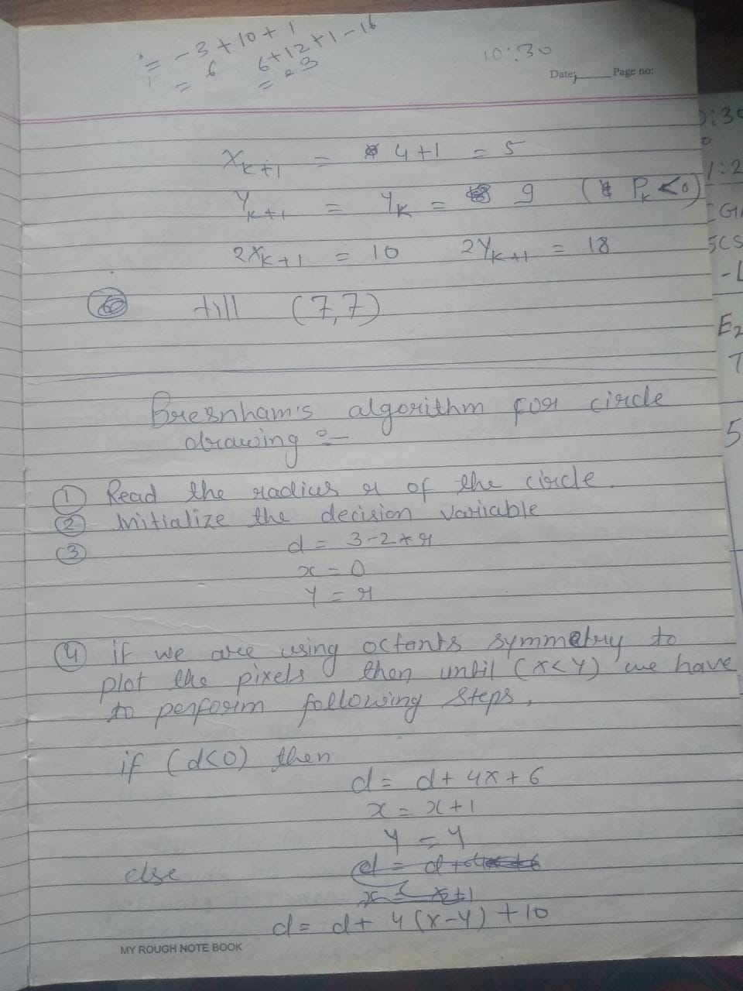

Slide 73
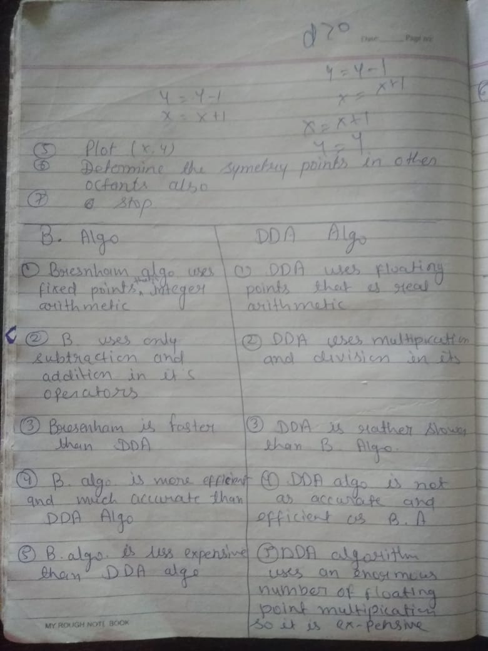

Slide 74
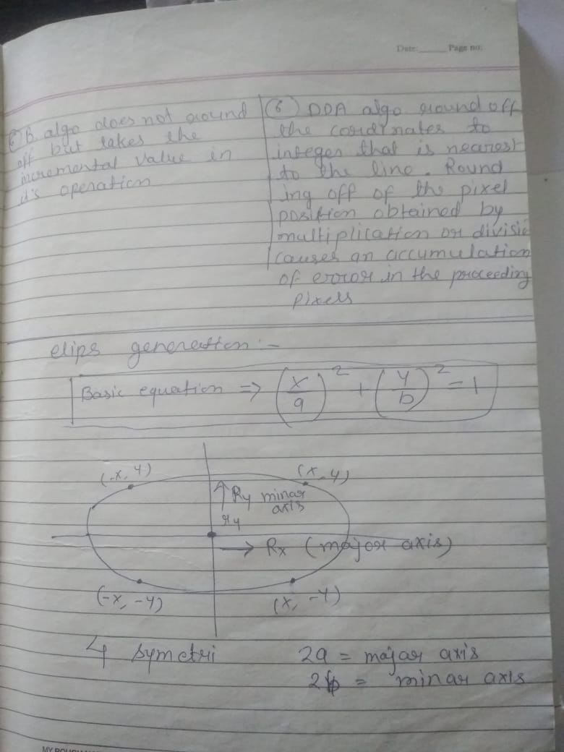

Slide 75
Important Points
Circle drawing algorithms take the advantage of 8 symmetry property of circle.
Every circle has 8 octants and the circle drawing algorithm generates all the points for one octant.
The points for other 7 octants are generated by changing the sign towards X and Y coordinates.
To take the advantage of 8 symmetry property, the circle must be formed assuming that the centre point coordinates is (0, 0).
If the centre coordinates are other than (0, 0), then we add the X and Y coordinate values with each point of circle with the coordinate values generated by assuming (0, 0) as centre point.

Slide 76
Disadvantages of Mid Point Circle Drawing Algorithm-
The disadvantages of Mid Point Circle Drawing Algorithm are-
Accuracy of the generating points is an issue in this algorithm.
The circle generated by this algorithm is not smooth.
This algorithm is time consuming.

Slide 77
P0=5/4-r 1-r
Advantages of Bresenham Circle Drawing Algorithm-
The advantages of Bresenham Circle Drawing Algorithm are-
The entire algorithm is based on the simple equation of circle X² + Y² = R².
It is easy to implement.
Disadvantages of Bresenham Circle Drawing Algorithm-
The disadvantages of Bresenham Circle Drawing Algorithm are-
Like Mid Point Algorithm, accuracy of the generating points is an issue in this algorithm.
This algorithm suffers when used to generate complex and high graphical images.
There is no significant enhancement with respect to performance.

Slide 78
bresenham’s circle drawing algo:
d = 3 - (2 * r) x = 0 y = r
Now for each pixel, we will do the following operations:
Set initial values of (xc, yc) and (x, y)
Set decision parameter d to d = 3 – (2 * r).
call drawCircle(int xc, int yc, int x, int y) function.
Repeat steps 5 to 8 until x < = y
Increment value of x.
If d < 0, set d = d + (4*x) + 6
Else, set d = d + 4 * (x – y) + 10 and decrement y by 1.
call drawCircle(int xc, int yc, int x, int y) function

Slide 79
X=0, y=8 d = 3 - (2 * r) d=3-(2*8) =-13
D<0
(1,8)
D=d + (4*x) + 6 d=-13+(4*1)+6 =-3
D<0 (2,8)
D=d + (4*x) + 6 d=-3+(4*2)+6 =11
D>0 (3,7)
d = d + 4 * (x – y) + 10 d=11+4(3-7)+10 d=5
D<0
(4,6)
(5,5)
X<=y

Slide 80
Polygon Filling Algorithms
Highlight all the pixels inside the polygon .2 approaches can be used
1. Scan Fill
2. Seed Fill (Boundary Fill, Flood Fill )

Slide 81
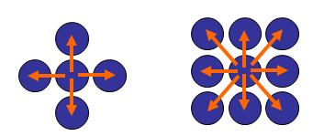
Boundary Fill Algorithm /Flood Fill algorithm
The boundary fill algorithm/ flood fill algorithm can be implemented by 4-connected pixels or 8-connected pixels.
X,y+1
X+1,y+1
x,+1,y
X+1,y-1
X,y-1
X-1,y-1
X-1,y
X-,y-1
X,y+1
X+1,y
X,y-1
X-1,y

Slide 82
Boundary Fill Algorithm
This algorithm picks a point inside the polygon and starts to fill until it hits the boundary of the object.
Assumption:
In this algorithm, we assume that color of the boundary is same for the entire object.

Slide 83
Boundary Fill Algorithm (Code)

Slide 84
Flood Fill Algorithm
Sometimes we want to fill in an area that is not defined within a single color boundary.
We paint such areas by replacing a specified interior color instead of searching for a boundary color value. This approach is called a flood-fill algorithm.

Slide 85
Flood Fill Algorithm (Code)

Slide 86
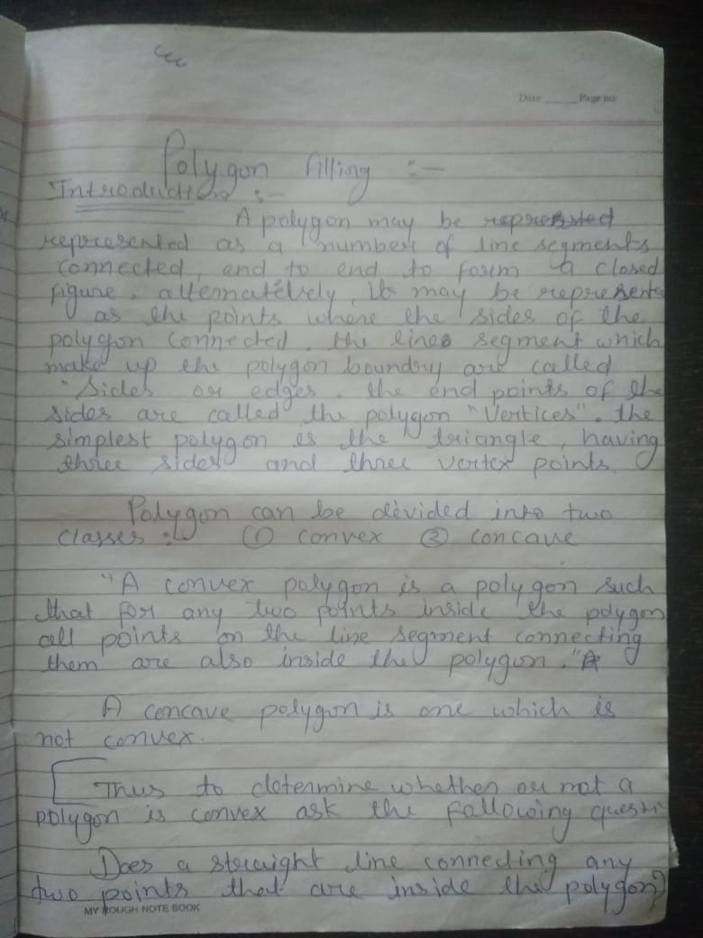

Slide 87


Slide 88


Slide 89


Slide 90


Slide 91


